Slide 1
Quantum Computing
Interests
Siddhant Rathi

Slide 2
INTERESTS
SOFTWARE
HARDWARE
• Quantum Image Processing
• Quantum Machine Learning
• Analog Simulations
• Optimization Problems
Photonics •
Quantum-Classical Interfaces •

Slide 3
QUANTUM IMAGE PROCESSING

Slide 4
USEFULNESS
With an increase in AI integration into devices and diversification of applications of ML techniques, much work is being done to optimize various aspects of the process of application of these techniques. Some examples are:
• Development of VPUs designed specifically for computer vision tasks for speed optimization.
• Integration of edge computing techniques into devices for improved privacy and speed.
• Development of electronic-photonic processors specifically keeping deep learning in mind.
• Development of specialized hardware architectures for machine learning.
Quantum Image Processing seems a promising field in the (long-term) future owing to the exponentially faster Quantum Fourier Transform as compared to the classical FFT. It will help enhance the speed of computer vision algorithms and might even be used to perform complex image processing tasks remotely.

Slide 5
PROCEDURE
Use Image Encoding methods such as FRQI to map the image onto qubits.
Use Quantum Fourier Transform to change the basis from Computational to Hadamard
Perform the required image processing operations
Take the Inverse Quantum Fourier Transform of the qubits
Retrieve the image using the measured (estimated) amplitude values

Slide 6
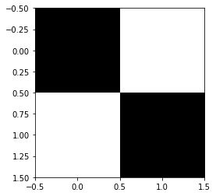
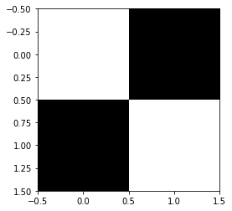
TRIAL PROGRAM
A program using the above techniques, based on the research article arXiv:1812.11042v3 and borrowing code from the Qiskit textbook was made to invert any 2x2 image using 3 qubits. It can be extended to 4x4, 8x8, 16x16, etc. image sizes by increasing the number of qubits by 2 for each subsequent size mentioned (precisely, we require (2N+1) qubits for an image of dimensions 2^{N}x2^{N} ).
A sample input-output pair from the program is as follows:
Input:
Output:

Slide 7
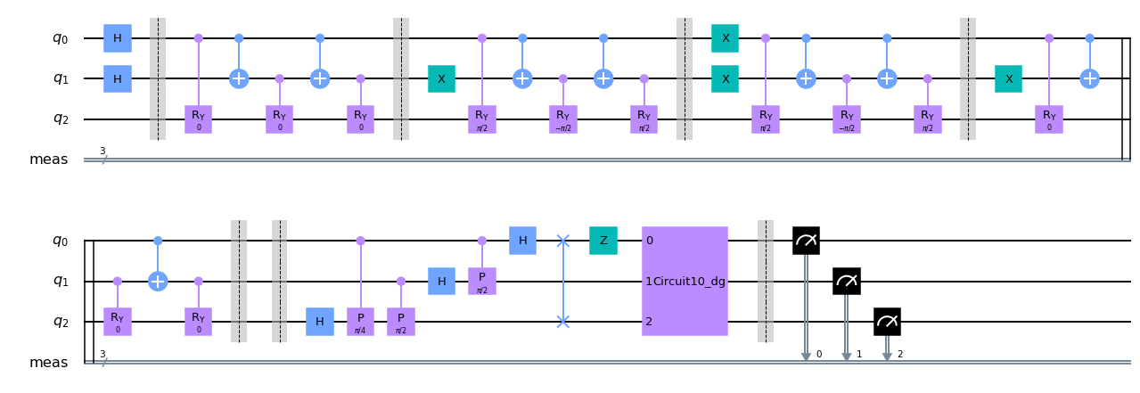
CIRCUIT DIAGRAM
FRQI
Inversion
IQFT
QFT

Slide 8
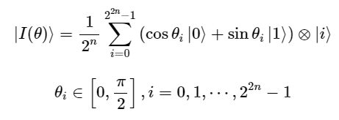
EXPLANATION
The Flexible Representation of Quantum Images (FRQI) encoding method represents an image using the equation
where θ_{i} represents the intensity of the pixel, and |i⟩ represents the pixel position. After encoding the image using FRQI, we apply QFT to switch to the Hadamard basis*. We apply a Z-gate to the first qubit, which represents the intensity, and then revert back to Computational basis using IQFT. Finally, we measure the qubits and use the results to reconstruct the inverted image.
Source: [1812.11042] Image Processing in Quantum Computers (arxiv.org)
* Note that applying QFT is not beneficial in this case, since we can simply replace QFT-Z-IQFT by just an X gate on the first qubit. The QFT was included just to draw a parallel to the classical image processing procedure.

Slide 9
EXPLANATION
Source: Quantum Fourier Transform (qiskit.org)
Alternatively, we can also see that H-Z-H is equivalent to X.

Slide 10
THANKS

